Slide 1
McSOC:
A scripted 'SOC in a BOX' network deployment
Ronald Broberg
December 2016

Slide 2
McSOC: Network Layout
Internet
DMZ
SOC
ENT SVR
DEV SVR
ENT WKS
DEV WKS

Slide 3
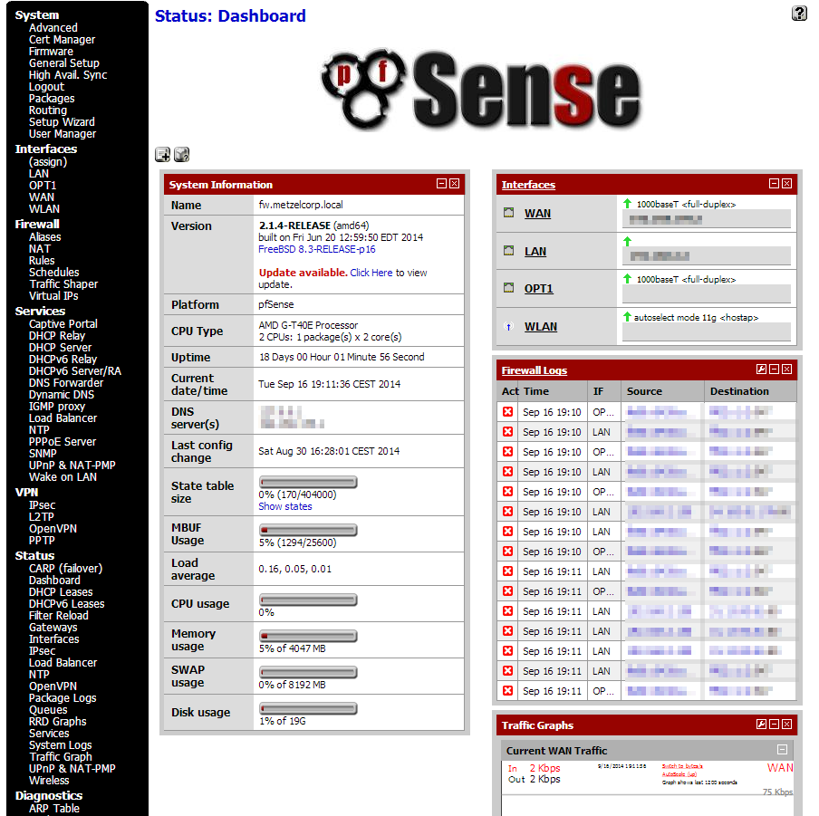
McSOC: - : ROUTERS
pfSense
  Firewall
  Routing
  SNMP
FreeBSD 10

Slide 4
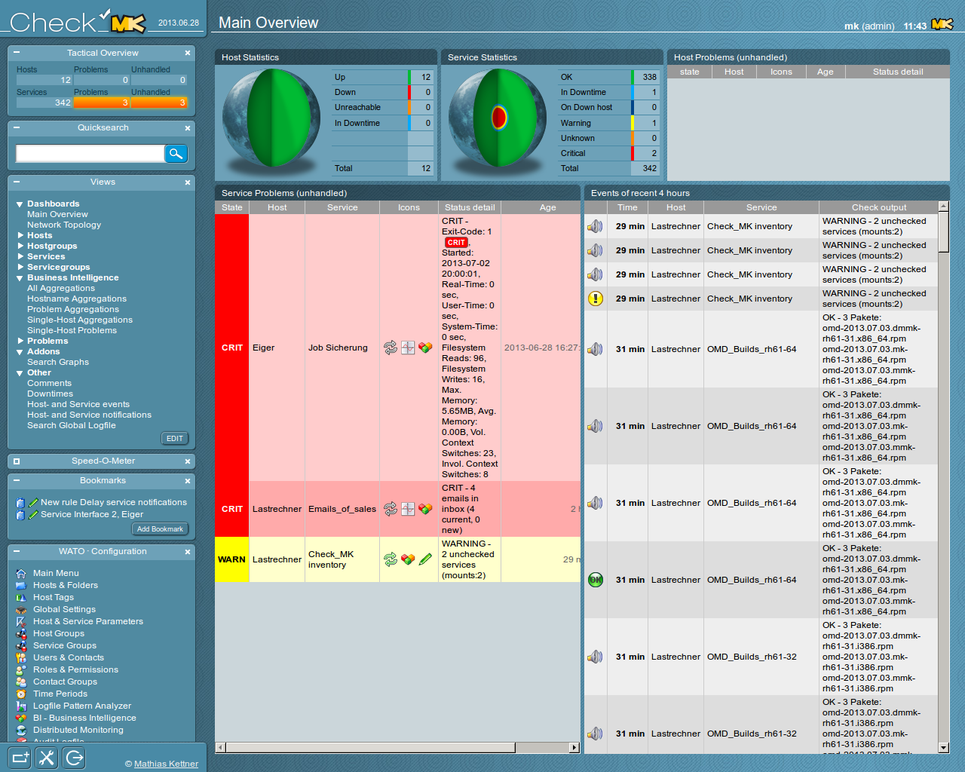
McSOC: SOC : NAGIOS
Network Monitor
  Check_MK
    Nagios Variant
    Liveevent Service
Ubuntu 16 Xenial

Slide 5
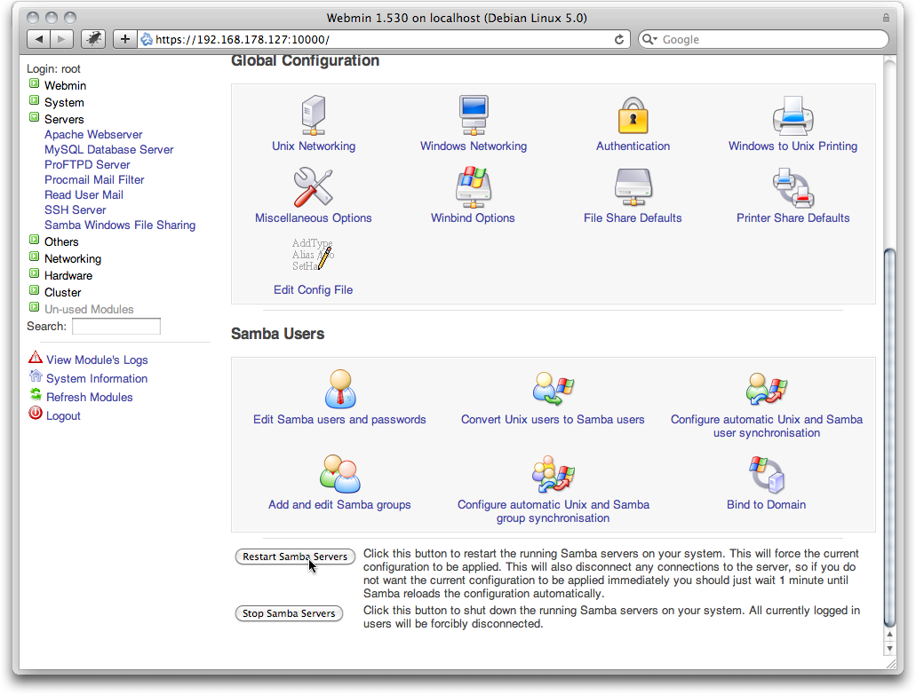
McSOC: ENTSVR : DC1
Domain Controller
  Samba4 Authentication
Mail Server
  PostFix
DNS Server
  Bind9
Debian 8 Jessie

Slide 6
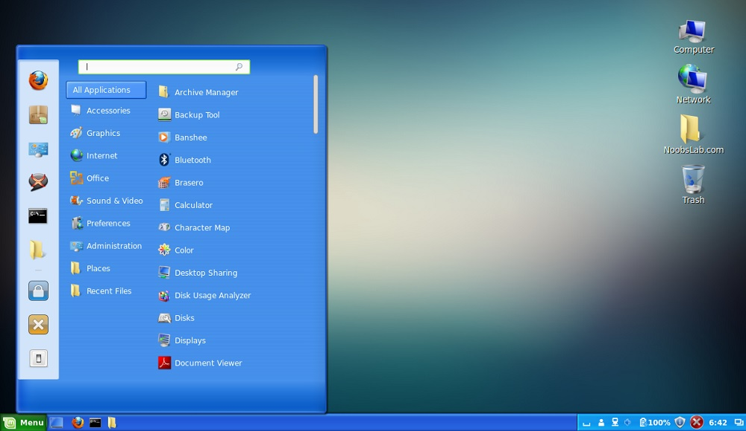
McSOC: ENTWKS : WKS101
Domain Client
  Samba4 Authentication
Mail Client
  PostFix
Web Browser
  Chrome ?
  Firefox ?
Mint Linux 14
Win 7 Look and Feel

